Slide 1
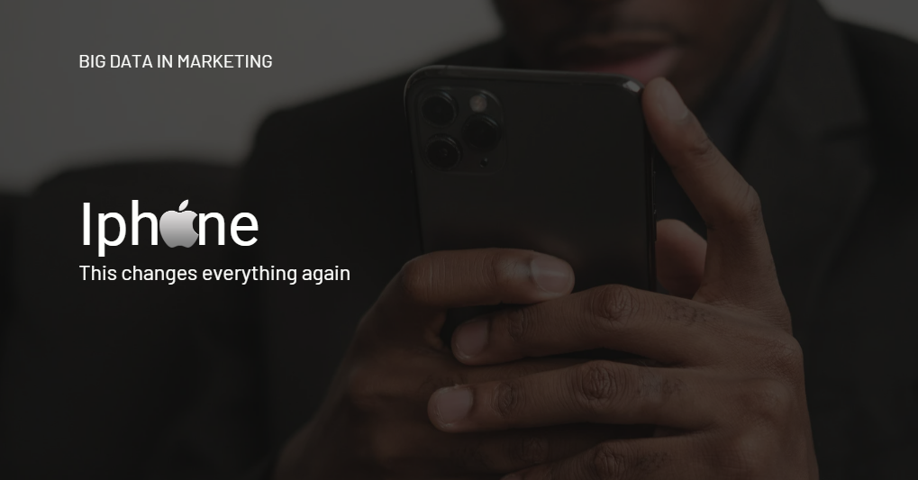

Slide 2
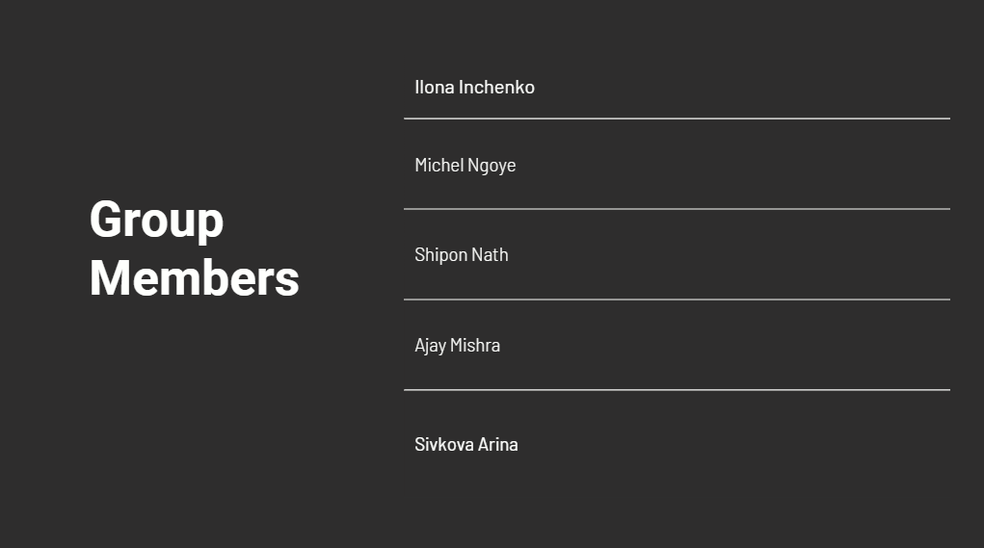

Slide 3
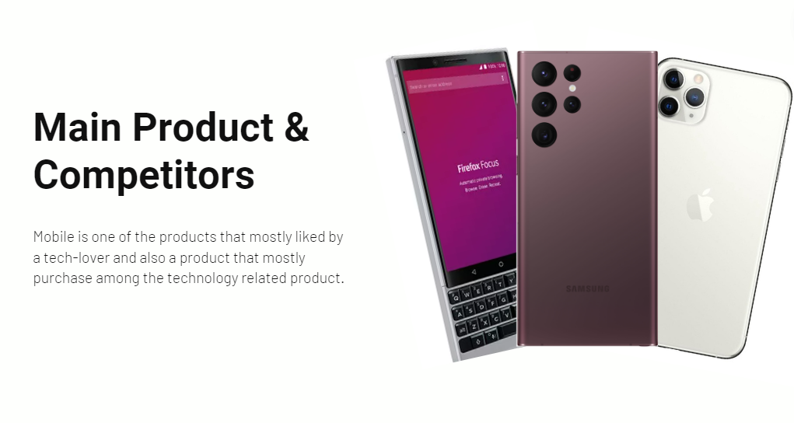

Slide 4
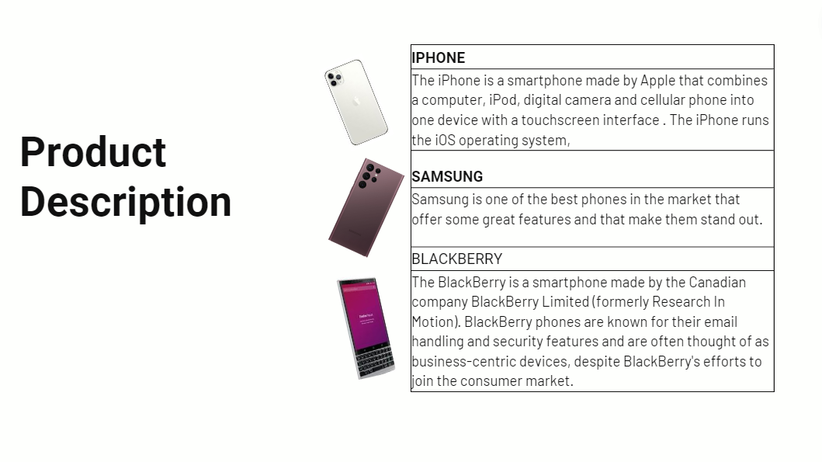

Slide 5
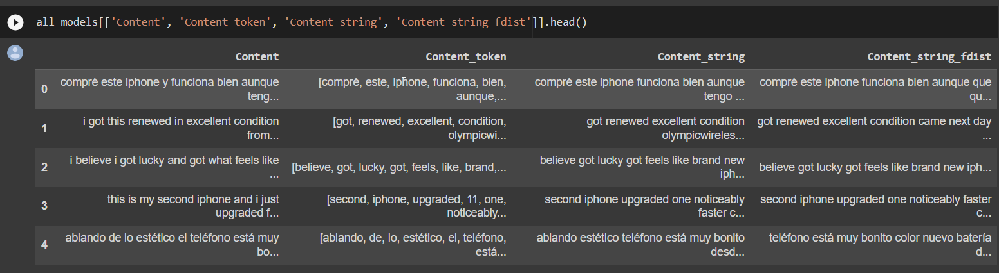
About Data
We parsed the data from amazon.com
Data Contains 2 files
1-File with phone models name and ID
2-File with customers reviews of phones
Changed data type for ex- columns "Content" and "Title" to string dtype
Cleaned the data and made ready to use
Proceeded for sentiment analysis

Slide 6
Sentiment Analysis -
The sentiment analysis process was done following these steps:
Tokenization: we use NLTK’s RegexpTokenizer to perform tokenization in combination with regular expressions (\w+) matches unicode word characters with one or more occurrences)
we drop the stopwords before analysing natural language data (we make a list of english stopwords) and we then use a lambda function to remove the stopwords
we also remove the infrequent words by using the fdist dictionary to drop words which occur less than a certain amount of time (we choose 4 as a parameter)
we then perform lemmatization of the dataset using WordNetLemmatizer
We finally word cloud and frequency distribution to visually display the data
To perform the actual sentiment analysis we use the VADER lexicon library and the polarity scores method
All details and codes regarding the process are available in the notebook attached to this presentation
Copy of Copy of marketing_parsing_sentiment.ipynb - Colaboratory (google.com)

Slide 7
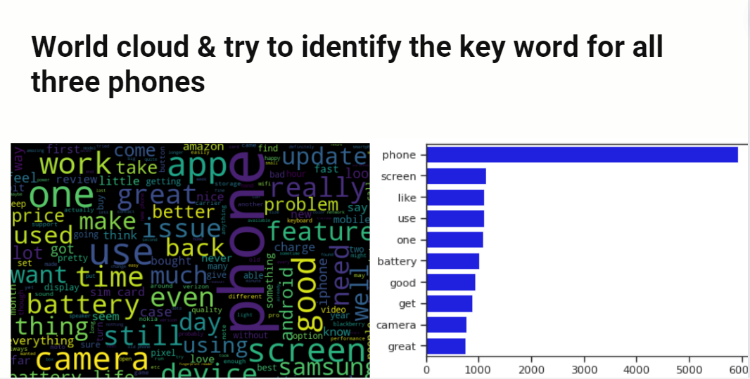

Slide 8
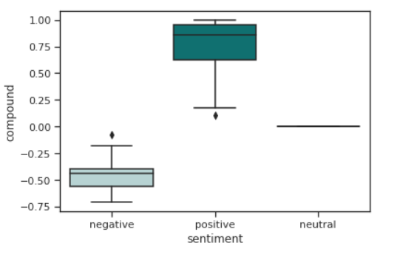
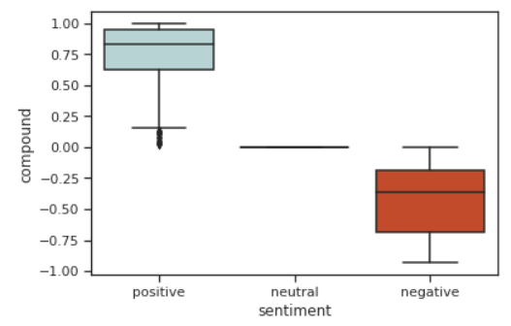
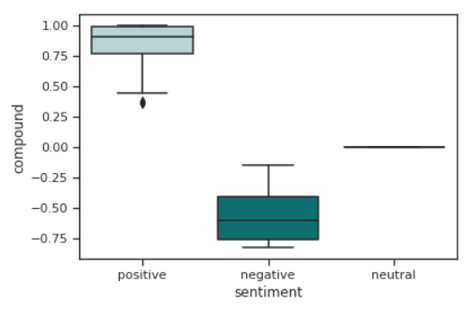
Splitting the dataset into three different companies and calculating the metrics
The dataset was then split into three different companies Apple, Samsung, and Blackberry:
the reputation metrics (SOV and NPS), the results can be found in the table below
Companies | SOV | NPS
Apple | 6.04 % | 41.30%
Samsung | 23.44% | 24.09%
Blackberry | 4.46% | 35.29%
Apple
Samsung
Blackberry

Slide 9
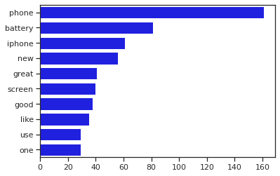
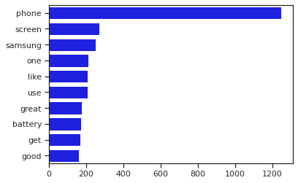
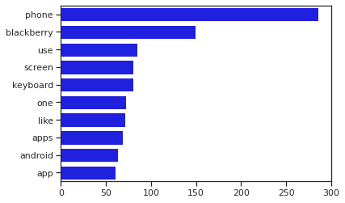
Topic Modeling and buzz around the Product-
We have 3 products Iphone is main product and Samsung, and Blackberry are competitors
After analysing the word cluster around them we found set of words which is occurred several times
Below graphs shows number of times occurred words making us to understand what is important in order to apex the product among the customers
Most occurred words make close cluster therefore we can say customers like to have features occurred frequently
Blackberry and Samsung has more popularity than iphone
Company can work on battery ,Screen ,Phone Memory Size in order to be more demanding among masses (As our Analysis shows)

Slide 10
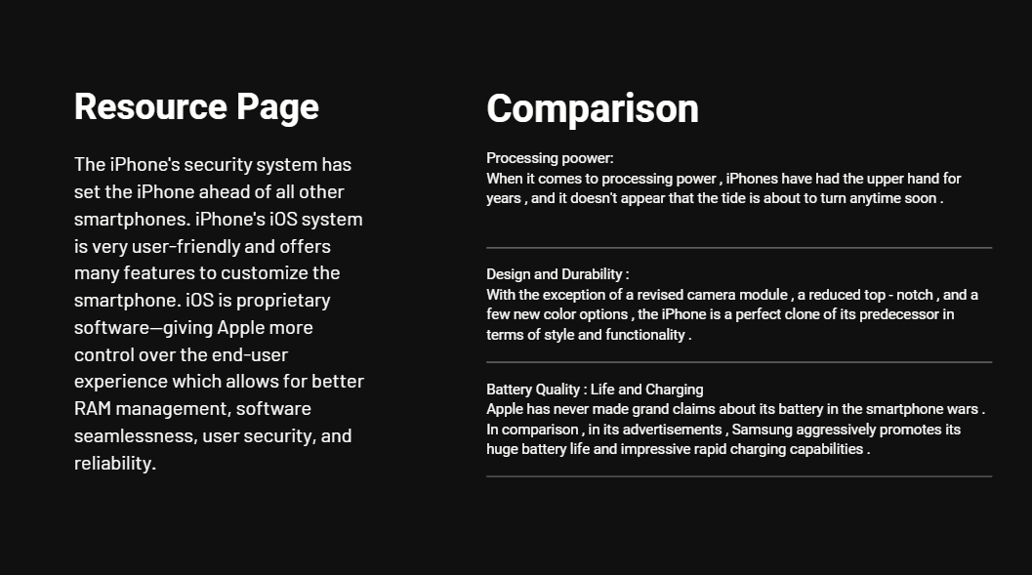

Slide 11
